Slide 1
Dispersion 1000/1 vs 1/1000 in Comparison corpus

Slide 2
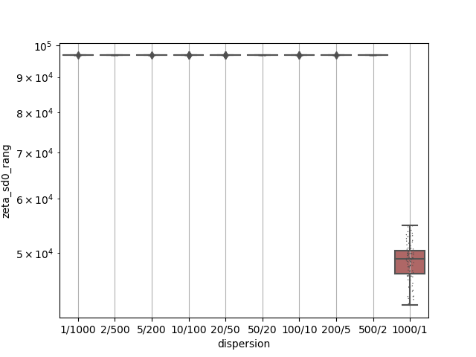
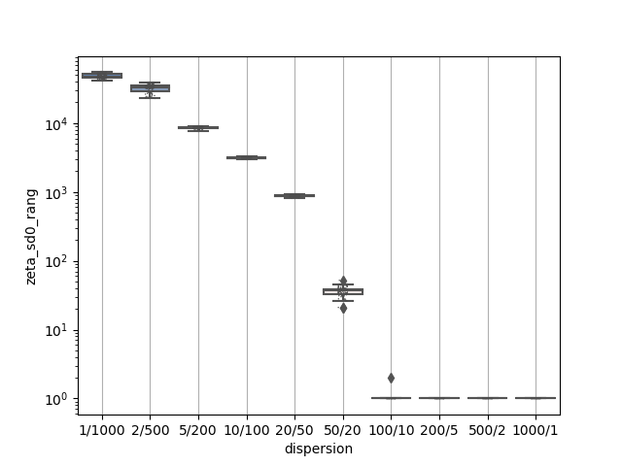
Zeta_0 results
1000/1 comparison
1/1000 comparison

Slide 3
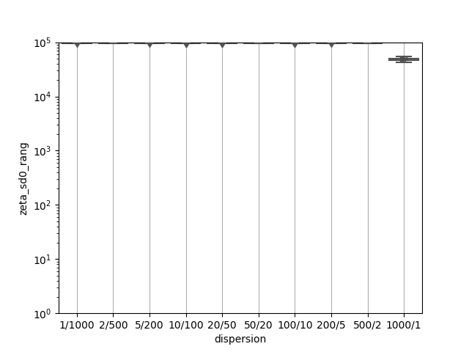
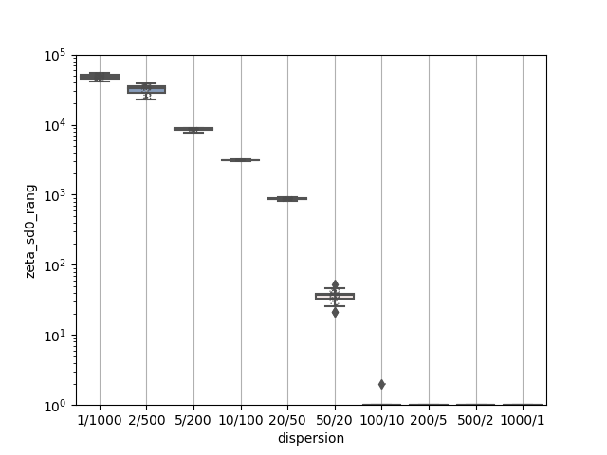
Zeta_0 results_limits
1000/1 comparison
1/1000 comparison

Slide 4
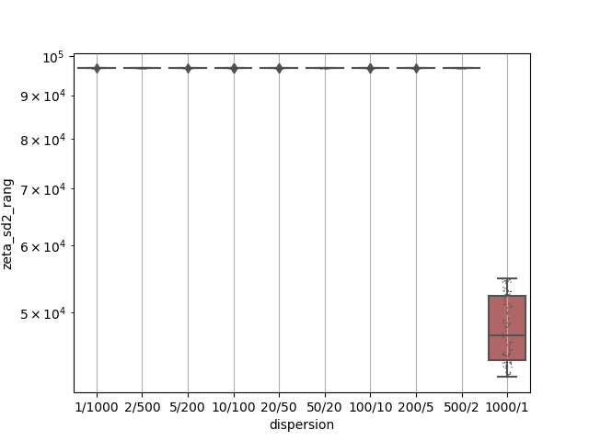
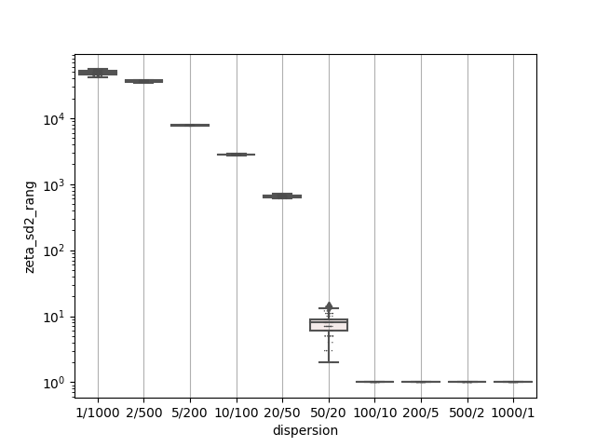
Zeta_2_results
1000/1 comparison
1/1000 comparison

Slide 5
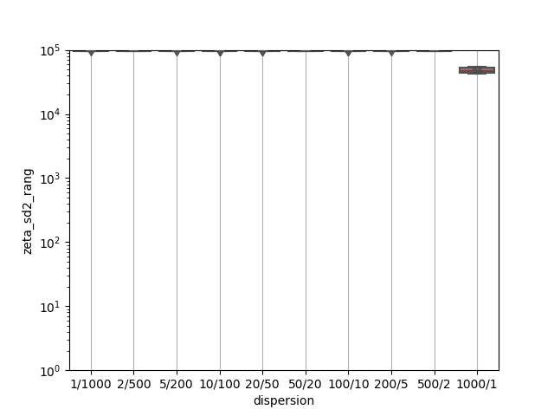
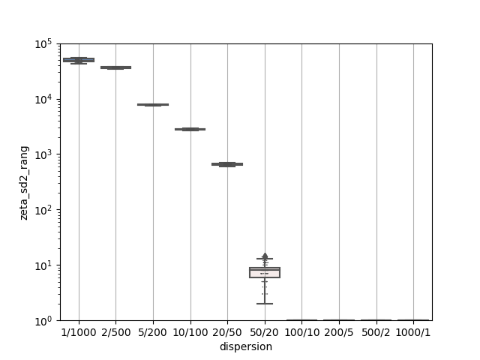
Zeta_2 results_limits
1000/1 comparison
1/1000 comparison

Slide 6
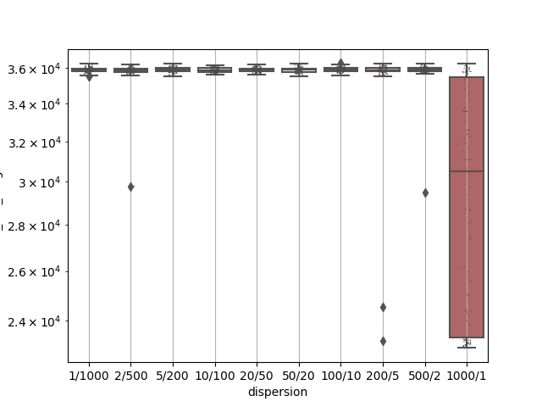
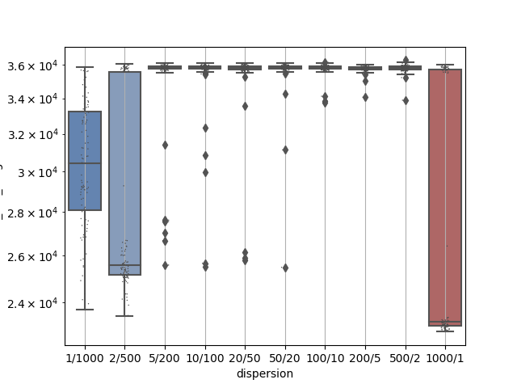
RRF_results
1000/1 comparison
1/1000 comparison

Slide 7
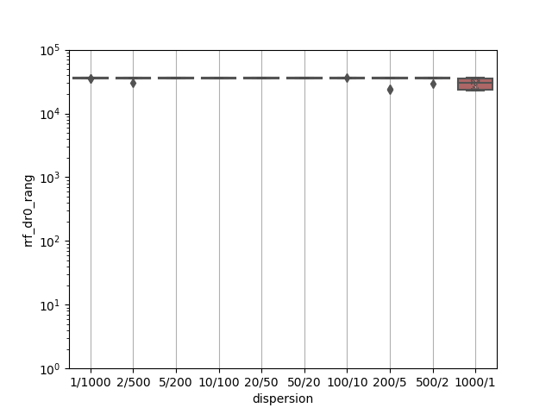
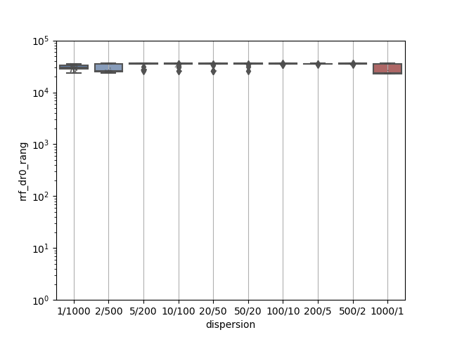
RRF_results_limits
1000/1 comparison
1/1000 comparison

Slide 8
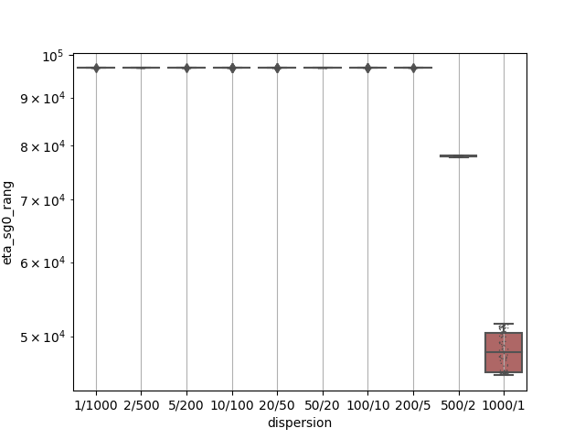
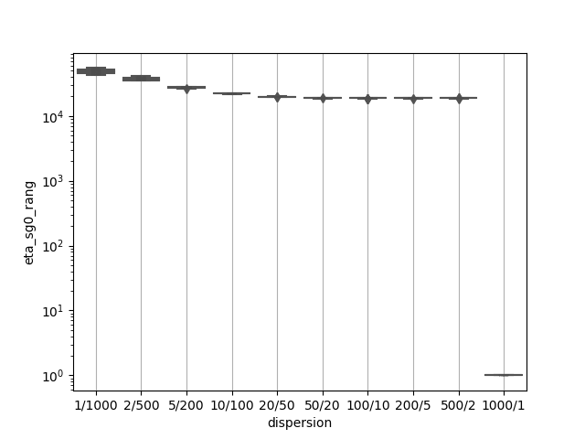
Eta_results
1000/1 comparison
1/1000 comparison

Slide 9

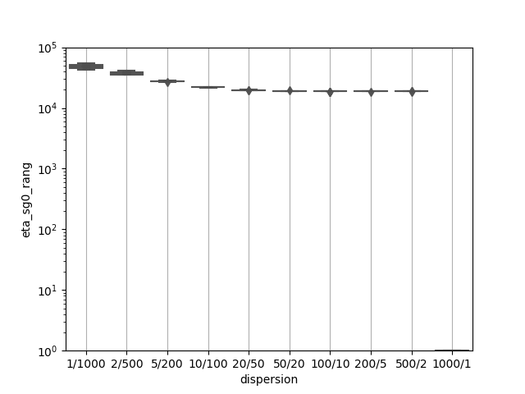
Eta_results_limits
1000/1 comparison
1/1000 comparison

Slide 10
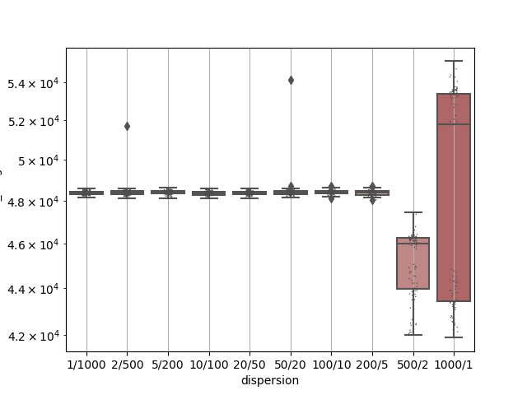
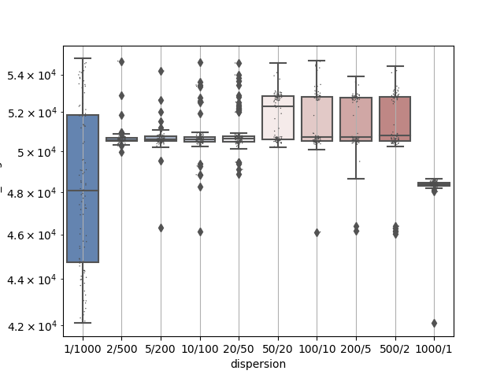
Welsh_results
1000/1 comparison
1/1000 comparison

Slide 11
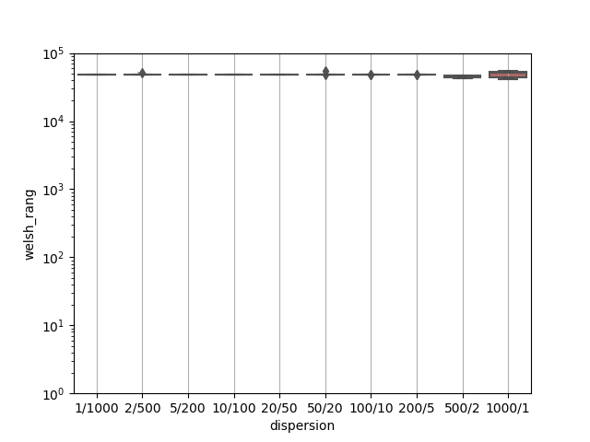
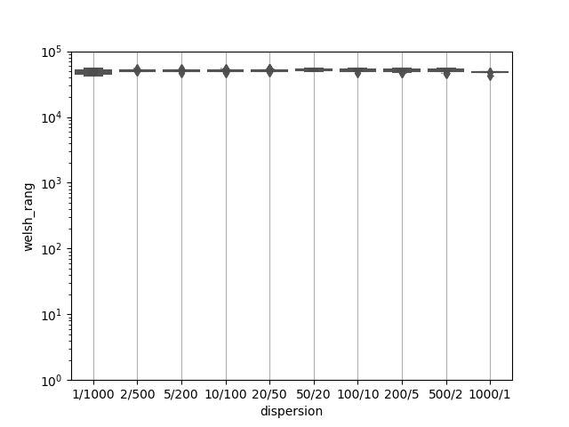
Welsh_results_limits
1000/1 comparison
1/1000 comparison

Slide 12
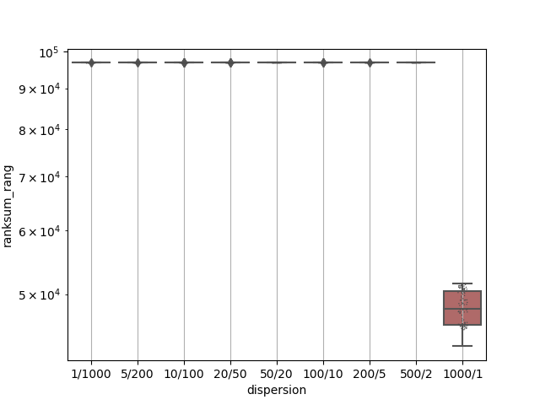
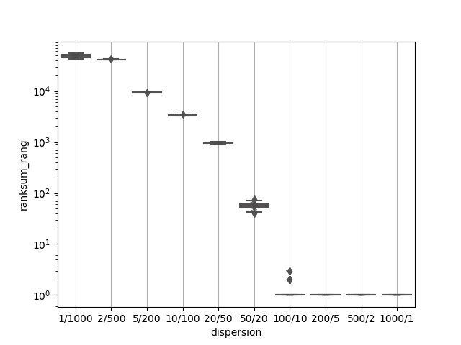
Ranksum_results
1000/1 comparison
1/1000 comparison

Slide 13
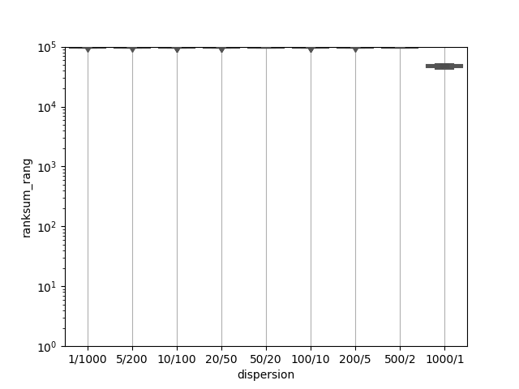
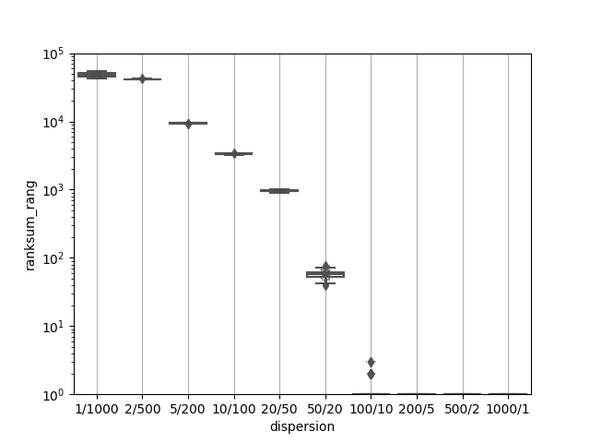
Ranksum_results_limits
1000/1 comparison
1/1000 comparison

Slide 14
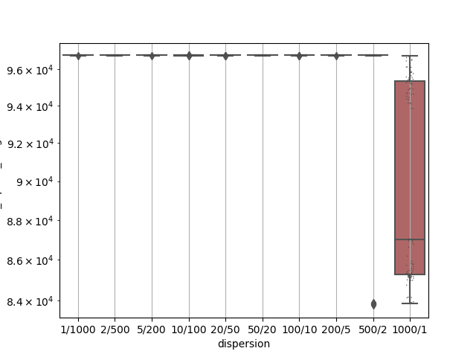
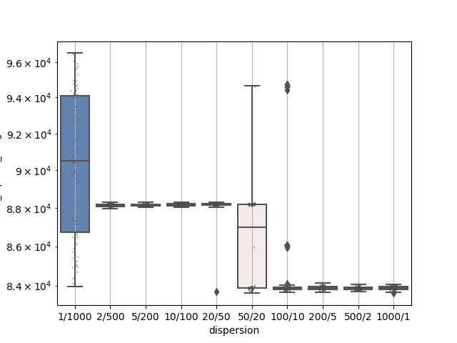
Chi-square_results
1000/1 comparison
1/1000 comparison

Slide 15
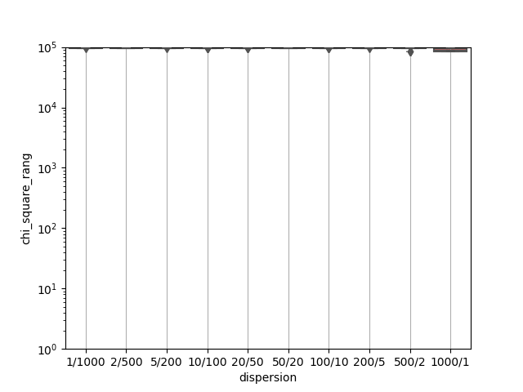
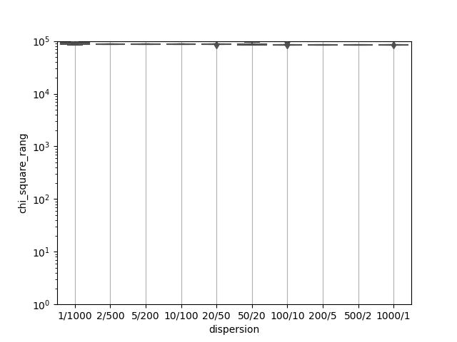
Chi-square_results_limits
1000/1 comparison
1/1000 comparison

Slide 16
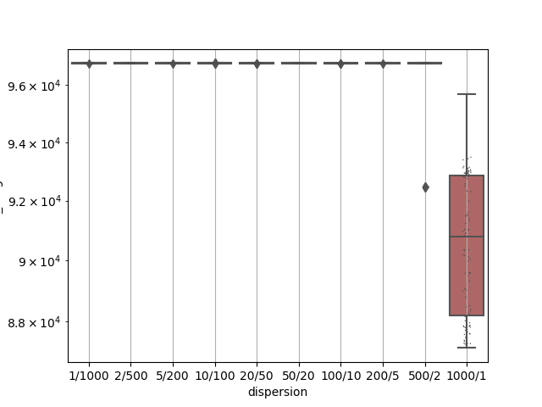
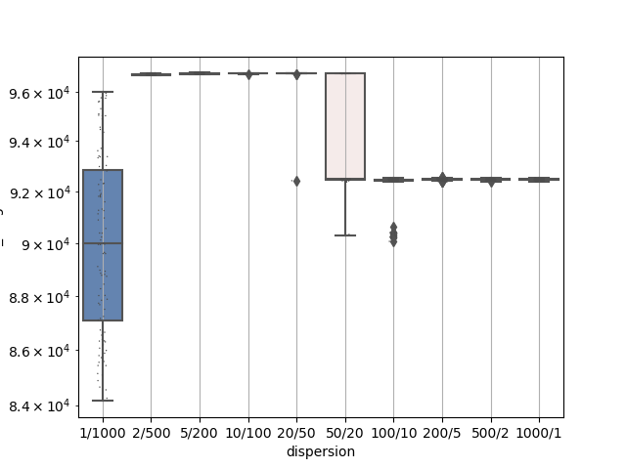
LLR_results
1000/1 comparison
1/1000 comparison

Slide 17
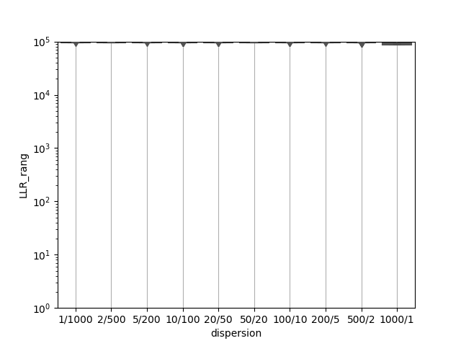
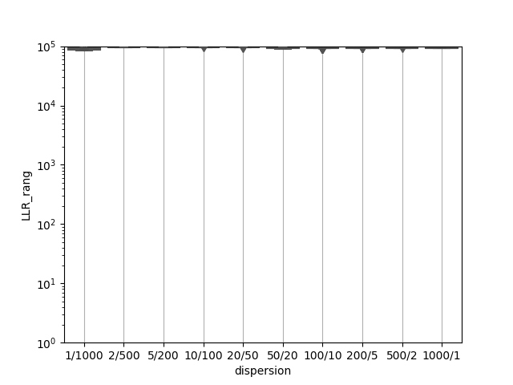
LLR_results_limits
1000/1 comparison
1/1000 comparison

Slide 18
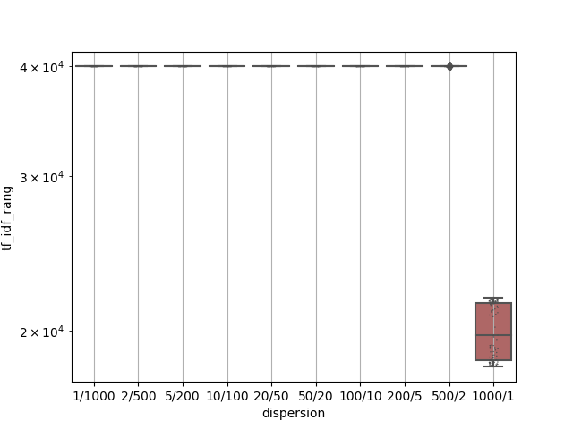
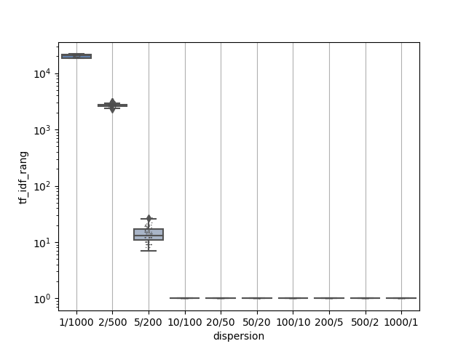
Tf-idf_results
1000/1 comparison
1/1000 comparison

Slide 19
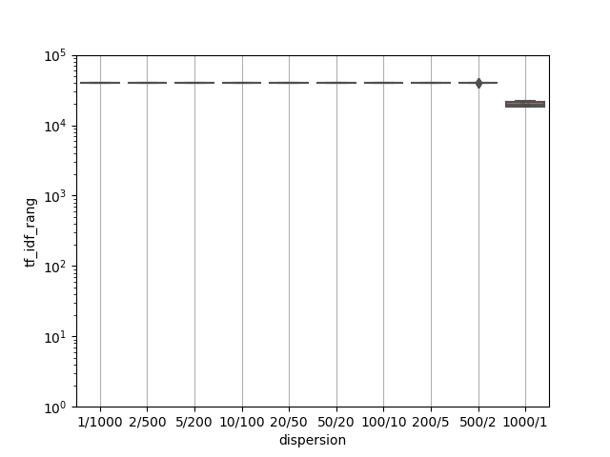
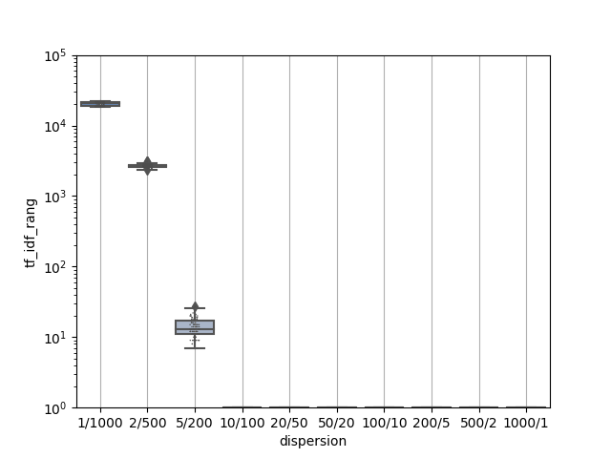
Tf-idf_results_limits
1000/1 comparison
1/1000 comparison

